Slide 1
Brazilian Association of Vegetable Oil Industries
Sustainable Soy Production in Brazil
Bernardo Pires
Sustainability Manager
Bogotá – 03/11/2015

Slide 2
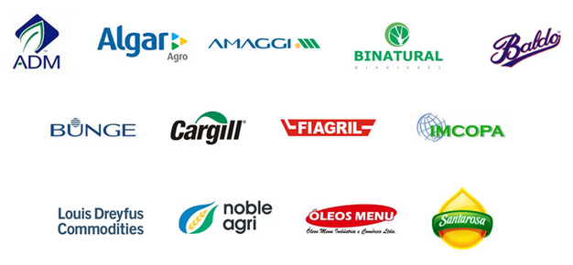
Brazilian Association of Vegetable Oil Industries
MEMBERS

Slide 3
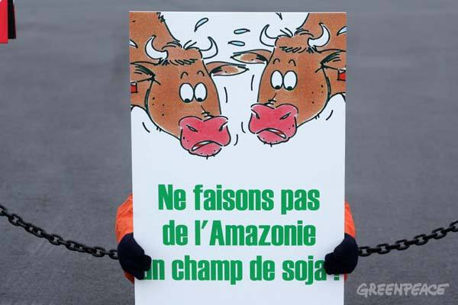

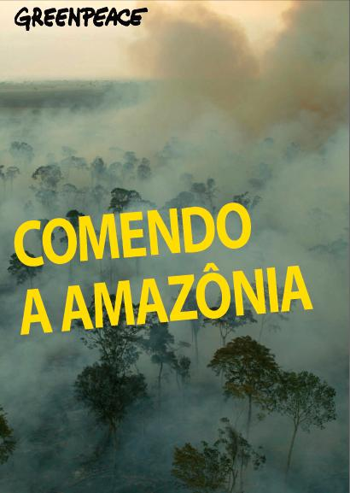
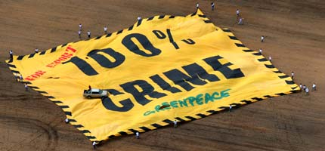
FORTE CAMPANHAS DE DESVALORIZAÇÃO DOS PRODUTOS AGRÍCOLAS BRASILEIROS
10 ANOS ATRÁS...
Notes:
3
A soja representa 30% da renda agrícola brasileira.
São cerca de 250 mil produtores no Brasil
No estados do sul, onde está metade da soja produzida no país, prevalece os pequenos e médio produtores e o sistema de cooperativas de produtores
O Complexo Soja gera cerca de US$ 9 bilhões em divisas por ano ao Brasil

Slide 4
MELHORIA DA GOVERNANÇA AMBIENTAL BRASILEIRA

Slide 5
IMPROVEMENT IN BRAZIL’S ENVIRONMENTAL GOVERNANCE
Governance Factors | 2004 | 2014
Deforestation rate – Amazon Biome | 27,772 km² | 4,848 km²
Environmental legislation | Provisional Measure Lack of legal security | New Forest Code Federal Law No. 12.651/2012
Penalties for illegal deforestation | Warnings and fines with low collections | Embargoes of farms and high fines
Monitoring of environmental crimes | Start-up of satellite use | Use of satellite images in real time with high definition
Field inspections | IBAMA technicians | Inspections integrated with Federal Police, Federal Highway Police, SEMAs and National Security Force
Requirements for purchasing agricultural products | No requirements | IBAMA’s Embargoed Areas Soy Moratorium Rural Environmental Registration Certifications

Slide 6
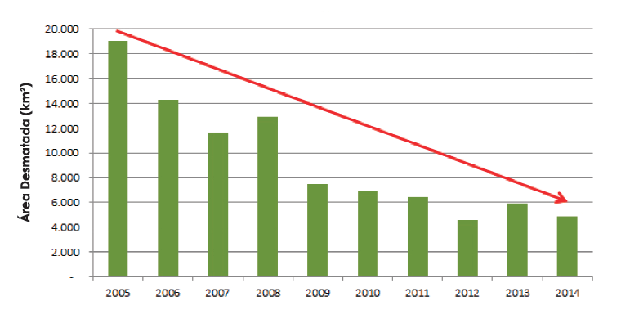
SHARP FALL IN DEFORESTATION
Deforestation rate in the Amazon Biome
over the last ten years, in km²
Fonte: INPE, 2015

Slide 7
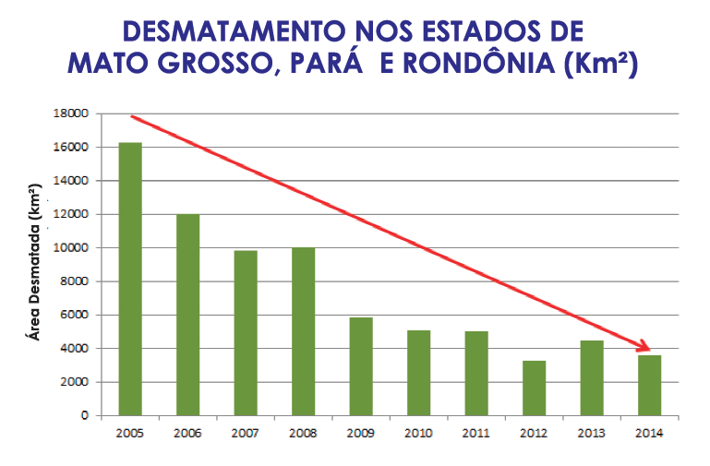
SHARP FALL IN DEFORESTATION

Slide 8
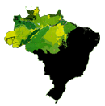
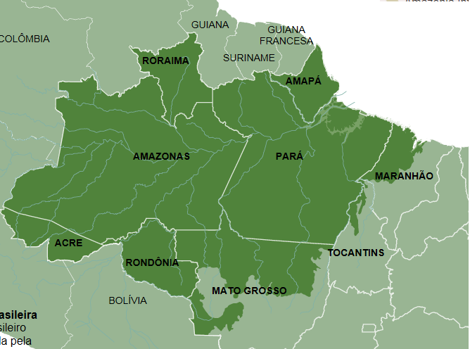
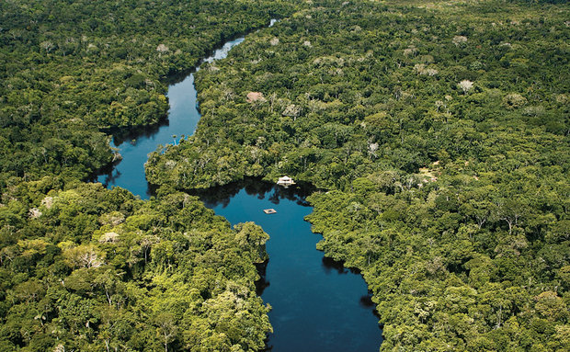
BIOMA AMAZÔNIA
- 408 millions ha (48% of Brazil)
- 80% of native vegetation preserved
Fonte: IBAMA 2004

Slide 9
EVOLUTION OF SOYBEAN PRODUCTION
BRAZIL (1975 – 2015)
12
Fontes: CONAB, 2015

Slide 10
TOTAL TRANSPARENCY COMMUNICATIONS IN BRAZIL
a) Deforestation and fires detection systems in real time on:
http://www.dpi.inpe.br/proarco/bdqueimadas
http://www.obt.inpe.br/deter/indexdeter.php
b) List kept by IBAMA (Brazilian Environmental & Renewable Natural Resources Institute) of embargoed areas due to ilegal deforestation:
http://siscom.ibama.gov.br/geo_sicafi/
c) List kept by the Ministry of Labour of locations using labour analogous to slavery:
http://www.mte.gov.br/trab_escravo/cadastro_trab_escravo.asp

Slide 11
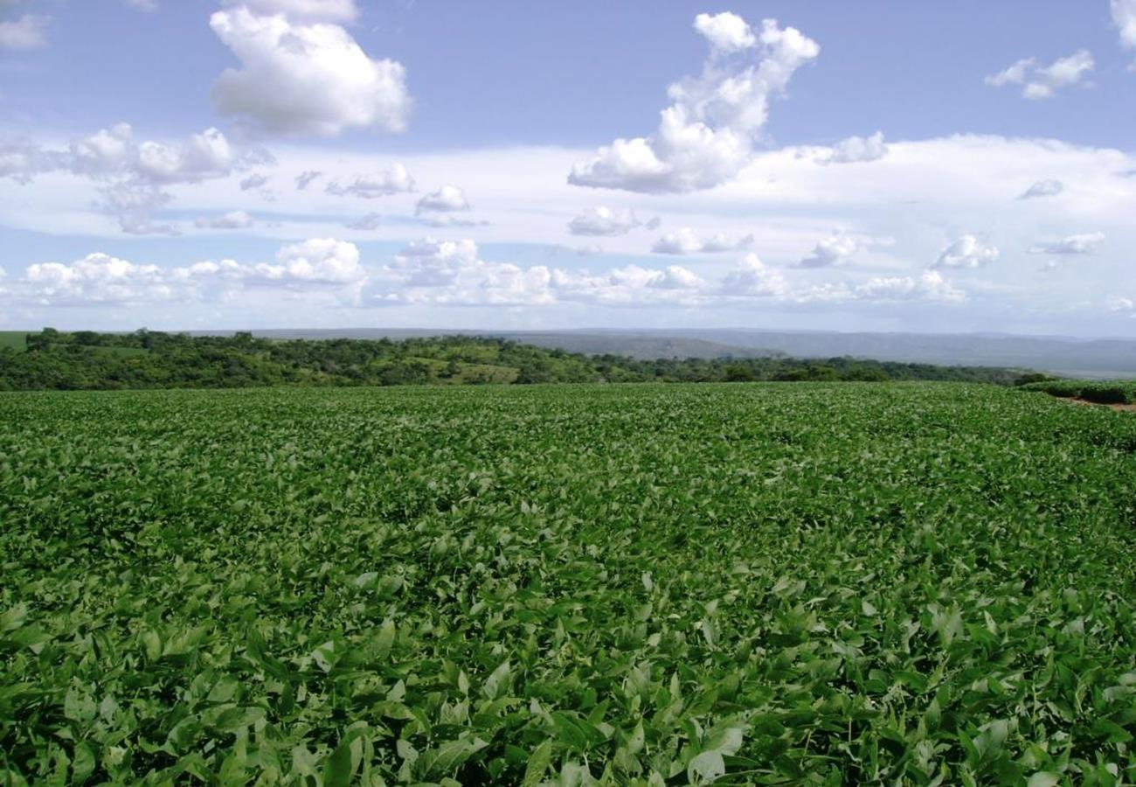
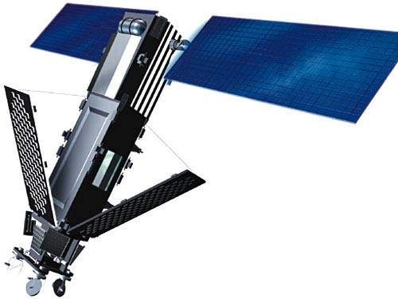
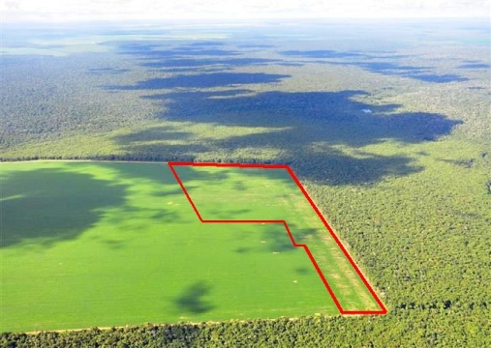
THE FARM AND THE RURAL PRODUCER ARE INCLUDED IN IBAMA’S LIST OF EMBARGOED AREAS IN BRAZIL
PUBLIC GOVERNANCE
LAW ENFORCEMENT
ILLEGAL DEFORESTATION
FARM IS
EMBARGOED
FINE
R$500/kg
purchased
DEFORESTATION
ALERT
INSPECTION
LEGAL DEFORESTATION

Slide 12
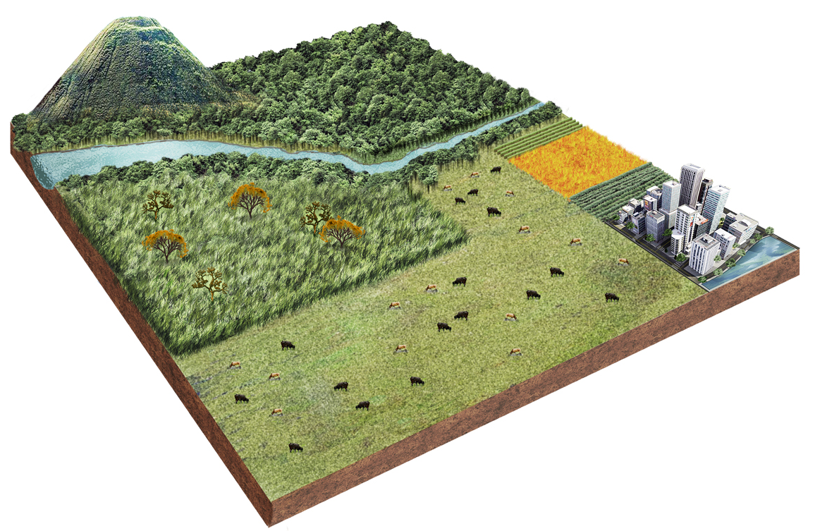
LAND USE AND OCCUPATION IN BRASIL
Brazil’s total land area = 851 million hectares
554 million hectares of native vegetation
177 million hectare in conservation units
103 million hectares in indigenous land
274 million hectares of native vegetations on private lands
65 millions hectares of productive land (grains, fruits and planted forests)
38 millions hectares in urbanized land
194 millions hectares of pastures
Fontes: Ministério do Meio Ambiente - MMA; IBGE, 2015

Slide 13
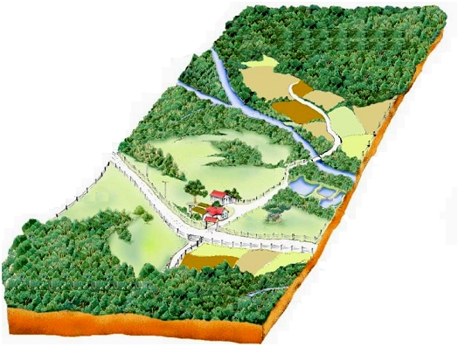
AREAS OF PRESERVATION
Environmental legislation guarantees that large areas of private land are preserved
Areas of Permanent Preservation (APP): along the margins of rivers and hilltops
Legal Reserve (RL): native vegetation must be preserved on 20% to 80% depending on the biome

Slide 14
Reserva Legal
APP
Silvicultura
Agrofloresta
Lavoura
Piscicultura
Pastagem
Apicultura

Slide 15
SOYBEANS ARE BRAZIL’S MAIN AGRICULTURAL CROP
Brazil is the world’s second largest producer and exporter of soy, with 96 million tons grown on 32 million hectares – 2014/2015
The soybean complex is one of the country’s main sources of foreign exchange (13% of total exports)
250,000 rural producers
1.5 million direct and indirect jobs
Notes:
15
Soybeans represent 30% of Brazil’s agricultural income.
There are some 250,000 soy producers in Brazil.
In Brazil’s southern states, where half the country’s soy production is located, small and medium producers prevail, using a system of co-ops.
The soybean complex generates about US$9 billion annually in foreign currency for Brazil.

Slide 16
Legal Reserve on Private Lands
Brazilian Amazon
vs.
U.S. Grain Belt
USA
Protected Areas (TI + UC)*
Drastic differences in environmental legislation
=
Competitive imbalance
USA
* TI=Indigenous Lands; UC=Conservation Units
Obligatory Minimum Width for Riparian Forests
(in metres)
USA
Source: IPAM – Daniel Nepstad

Slide 17
PROGRAMAS DE SUSTENTABILIDADE
e
CERTIFICAÇÕES
DA SOJA BRASILEIRA

Slide 18


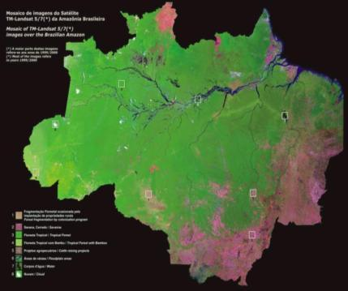
SOY MORATORIUM
Monitoring 98% of the soybeans grown in the Amazon Biome since 2006
Signed: July 24, 2006
Objective: To reconcile economic development with socio-environmental preservation in the Amazon Biome
Commitment: Signatories will not trade soybeans produced in areas of the Amazon Biome deforested after July 2008
Notes:
18

Slide 19
SOY MORATORIUM - MEMBERS OF THE GTS
BUSINESS SECTOR
GOVERNMENT
CIVIL SOCIETY
ABIOVE
ADM
AMAGGI
ANEC
BUNGE
CARGILL
LOUIS DREYFUS
FIAGRIL
ANEC
EUROPEAN CONSUMERS
GREENPEACE
EARTH INNOVATION
IPAM
TNC
IMAFLORA
WWF BRASIL
CONSERVATION INTERNATIONAL
MINISTRY OF THE ENVIRONMENT
BANK OF BRAZIL
ENVIRONMENTAL SECRETARIATS OF MATO GROSSO AND PARÁ STATES
NATIONAL SPACE RESEARCH INSTITUTE

Slide 20


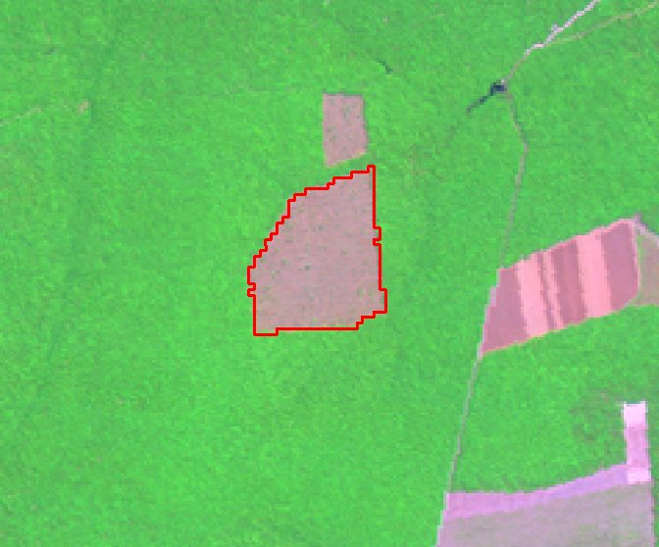
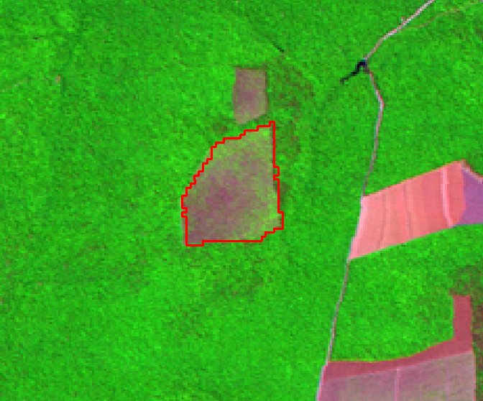
SOY MORATORIUM - SATELLITE IDENTIFICATION
Landsat 7 Satellite Image Identifies Deforestation
PRODES 2014
PRODES 2015
Notes:
20

Slide 21
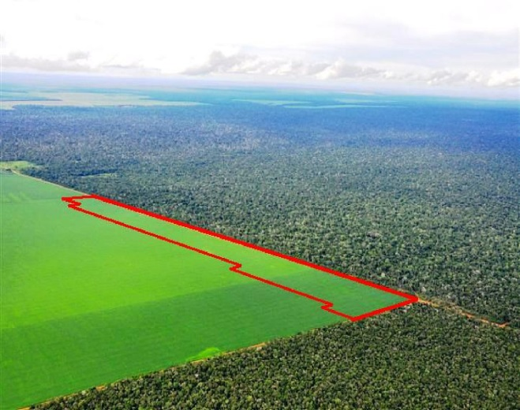
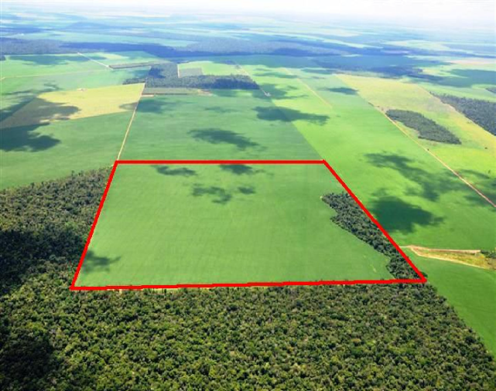
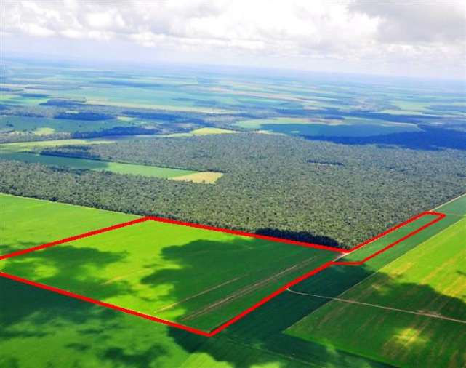
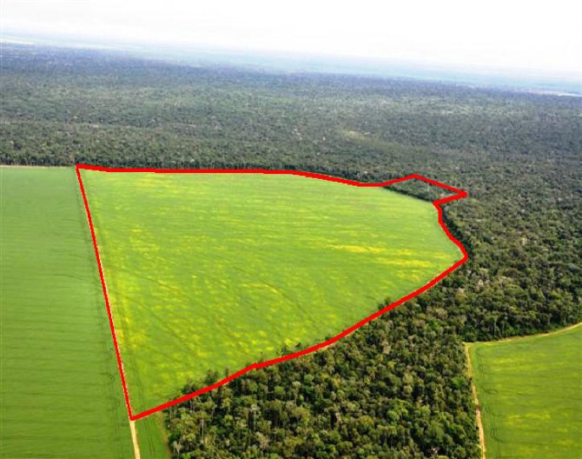
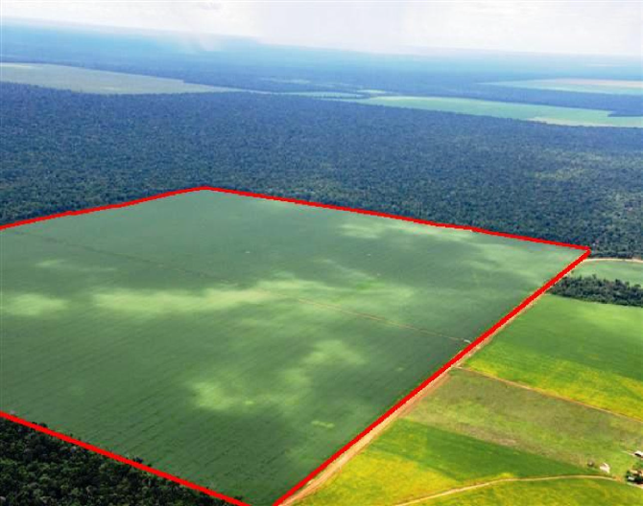
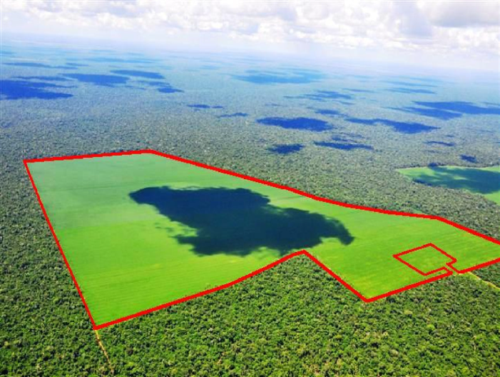
SOY MORATORIUM - AERIAL PHOTOS IDENTIFIES DEFORESTATION

Slide 22
RECOGNITION BY INTERNATIONAL CLIENTS
The European Soy Customer Group – AHOLD, ASDA, Carrefour, Co-operative, Kraft, Marks & Spencer, McDonald’s, Nutreco, Ritter-Sport, Sainsbury’s, Waitrose and Wal-Mart – applauds another year of positive progress by the Soy Task Force:
“We see the Moratorium as a powerful and essential tool to enable all of us to achieve our ultimate goal of sustainable sourcing. We encourage other companies and other sectors to engage in similar efforts to ensure that the Amazon is not cleared for the production of any commodity. In particular, we would like to acknowledge the further improvement of the mapping and monitoring system, now supported by the involvement of National Institute of Space Research (INPE) in Brazil.”

Slide 23



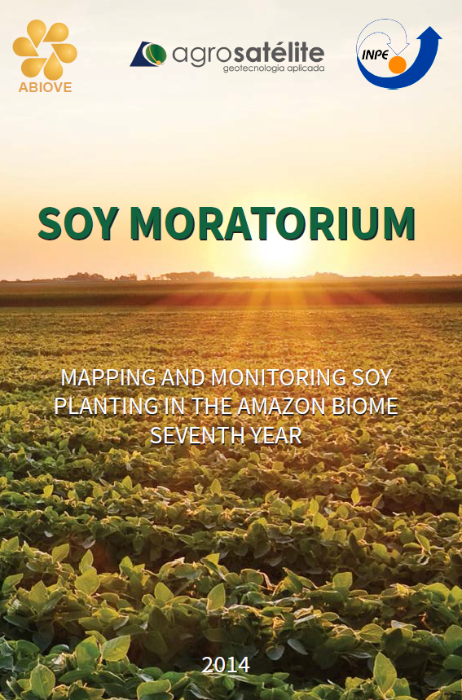
SOY MORATORIUM (2006-2015)
3,6 milhões de ha de soja livres de desmatamento
10,8 milhões de toneladas de soja sustentável produzidas no Bioma Amazônia

Slide 24


Economic, Environmental and Social Management
Programme for Brazilian Soybeans

Slide 25
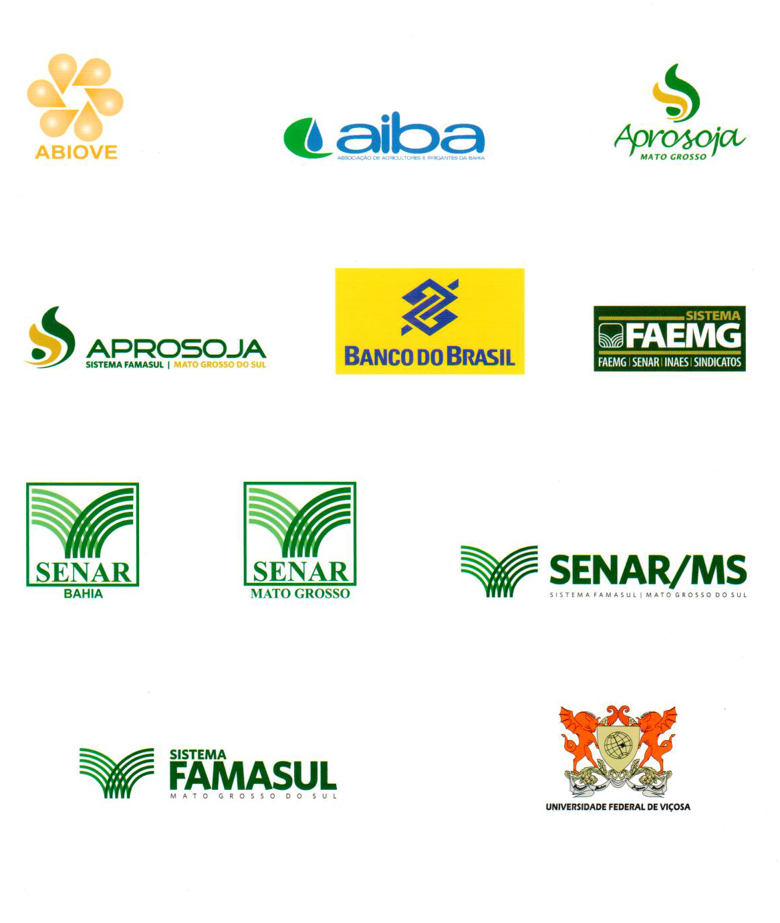
MEMBERS

Slide 26
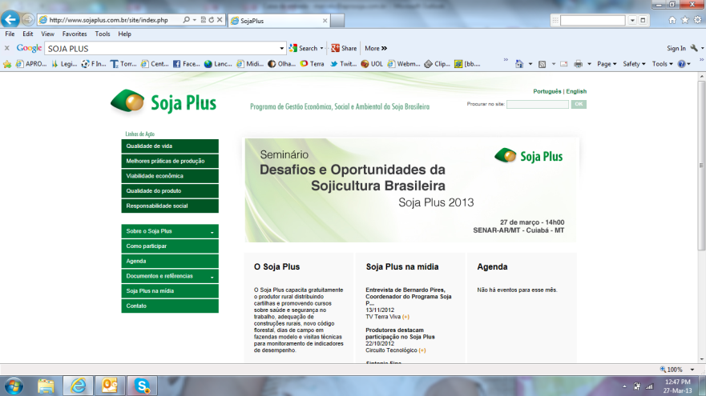
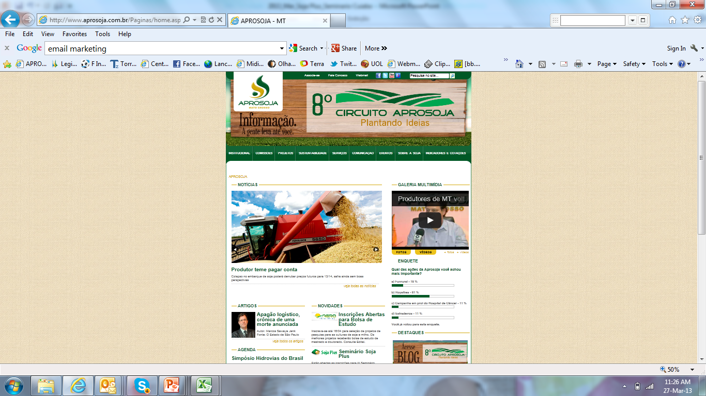


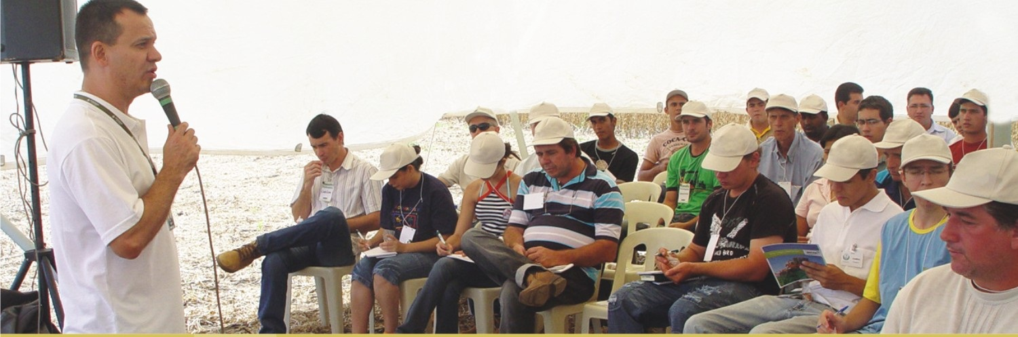

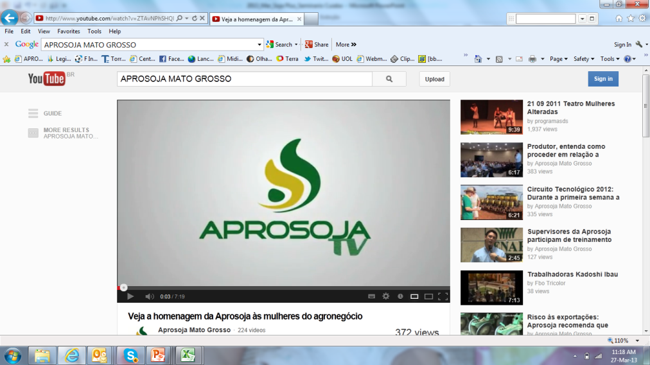
HOW DO WE GET GREAT RESULTS?
Communications and Good Relationships with Producers

Slide 27
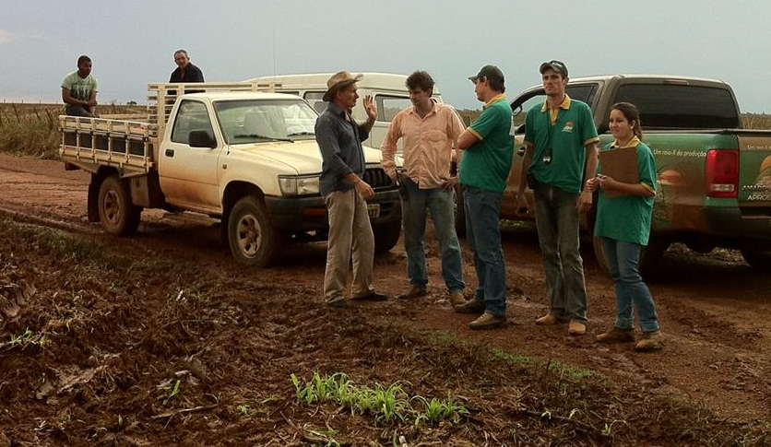
HOW ARE WE GETTING GREAT RESULTS?
2011 – States of Mato Grosso
2013 – State of Mato Grosso do Sul
2014 – States of Minas Gerais and Bahia
28 Nuclei of Producers
40 Rural Trade Unions
6 Field Teams – 32 agronomist

Slide 28
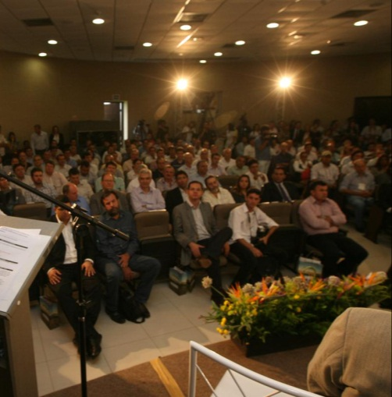
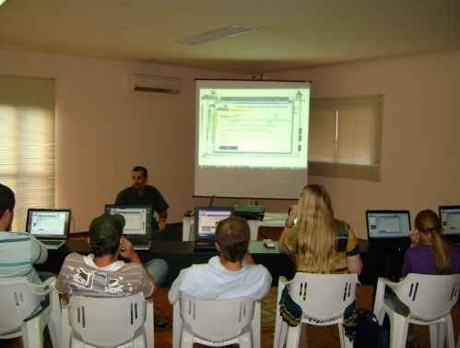
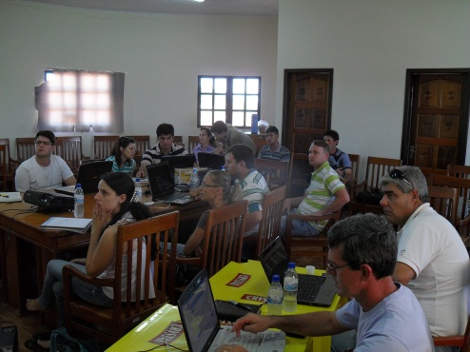
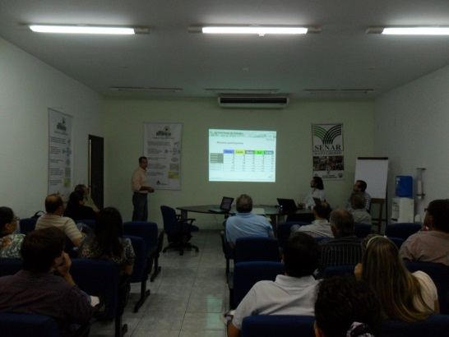
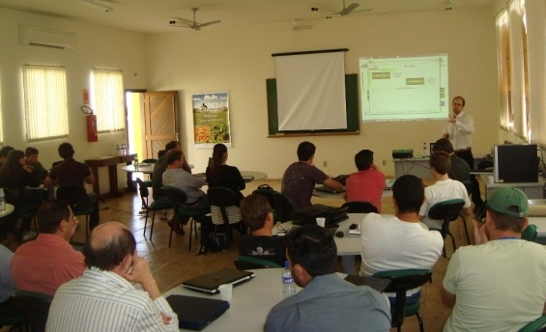
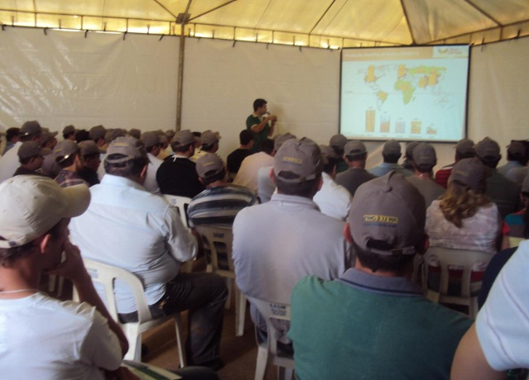
HOW ARE WE GETTING GREAT RESULTS?
Capacity for mobilizing rural producers

Slide 29


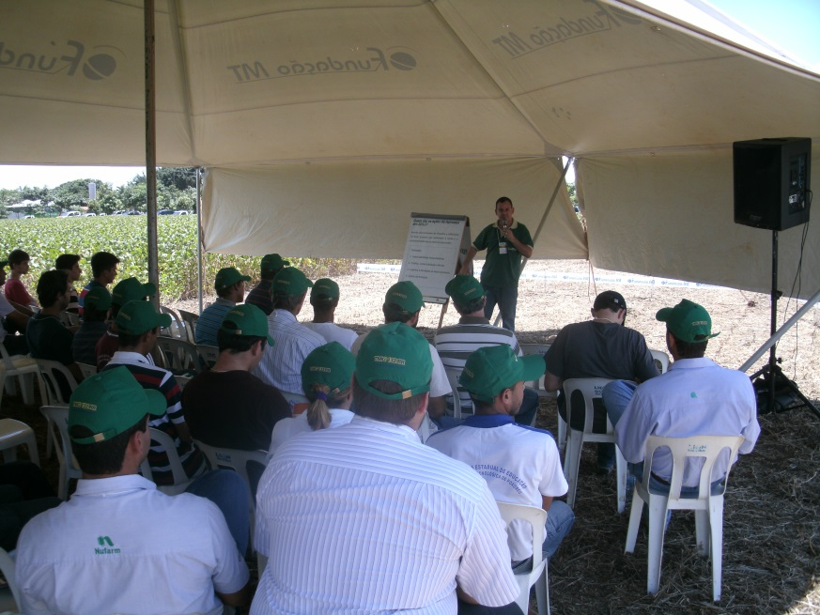
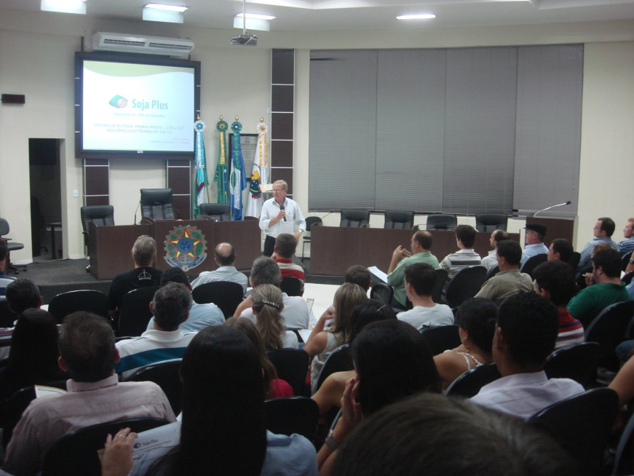
DIAS DE CAMPO E CURSOS

Slide 30
Duration of Course: 16 hours
2011
25 courses
392 participants
2012
24 courses
283 participants
2013
18 courses
213 participants
2014
18 courses
263 participants
2015
14 courses
178 participants
2012/2015
5 Fiel Days
250 participants
Total 1.579
participants
trained

Slide 31
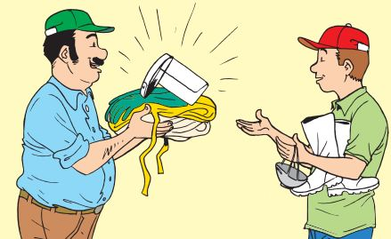
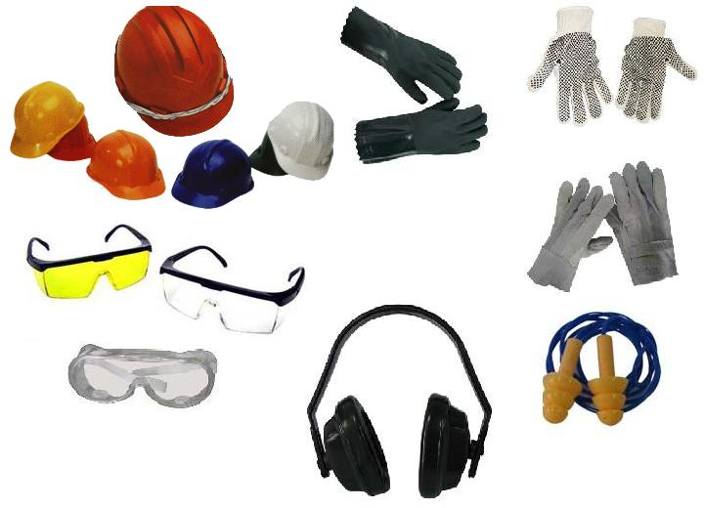
SOJA PLUS FARMS
Supply, free of charge, personal protection equipment, training workers in their proper use and requiring that they use them

Slide 32
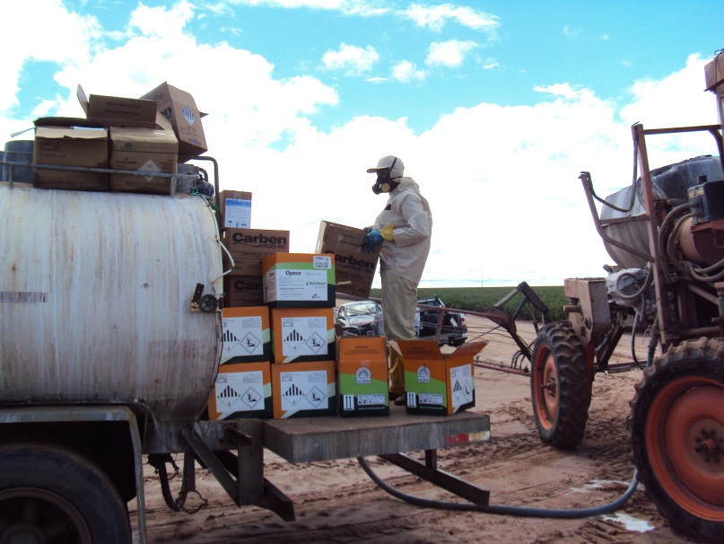

Slide 33
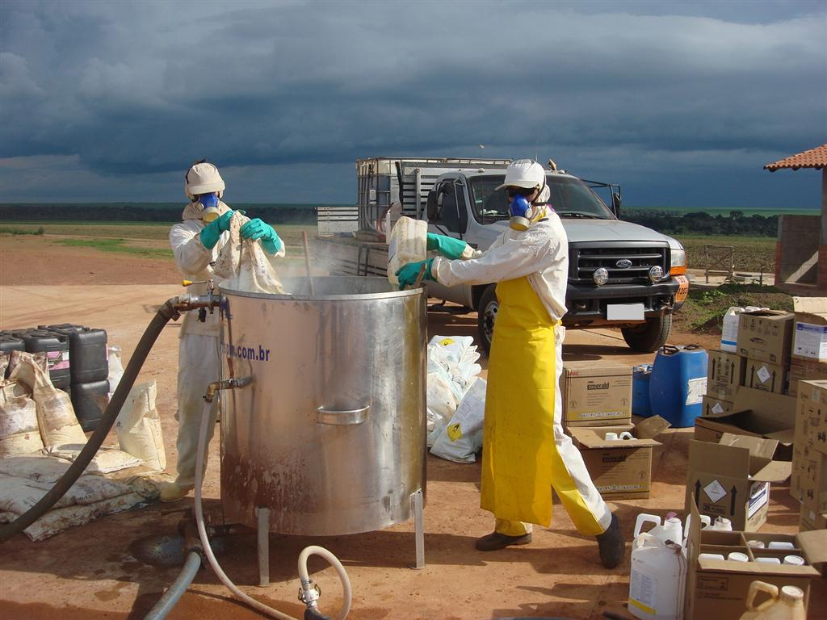
EPI adequado ao trabalho

Slide 34
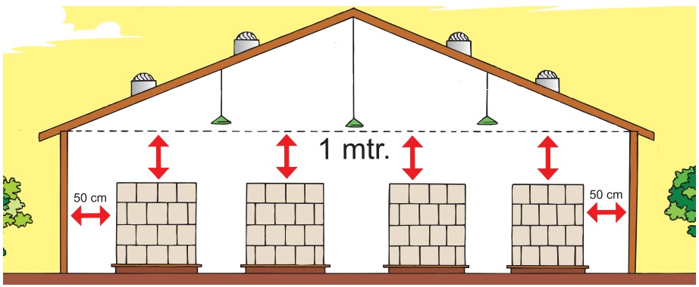
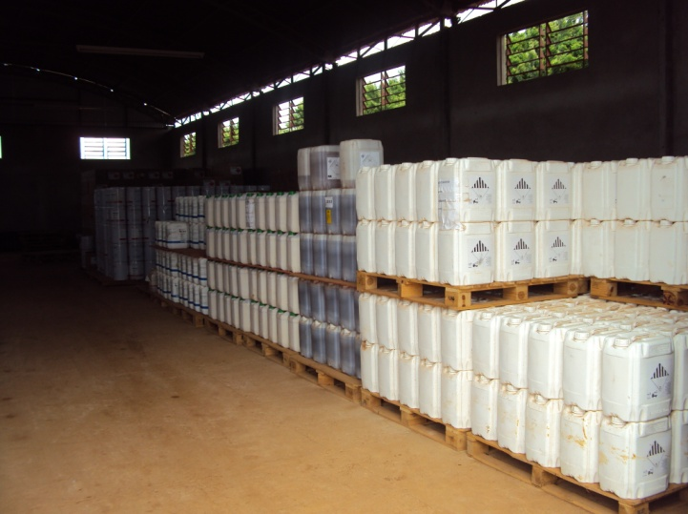
SOJA PLUS FARMS
Packed products deposited on pallets and away from walls
Stacks of boxes at the height established by the manufacturers

Slide 35
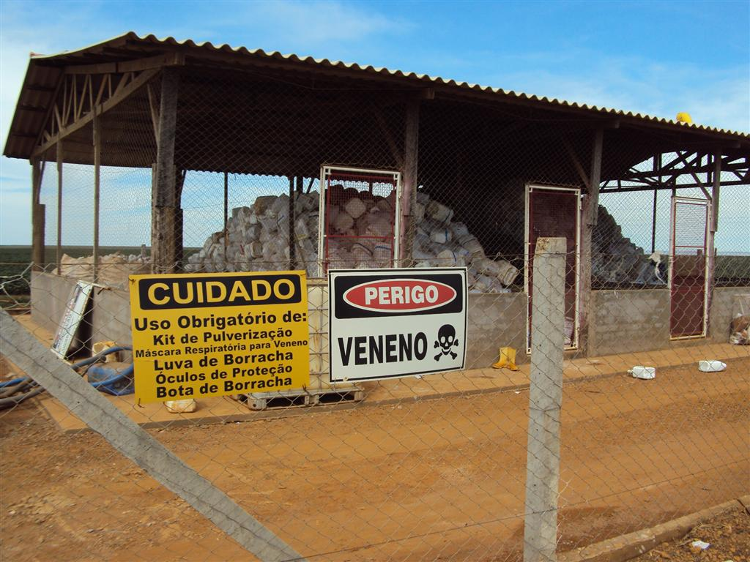
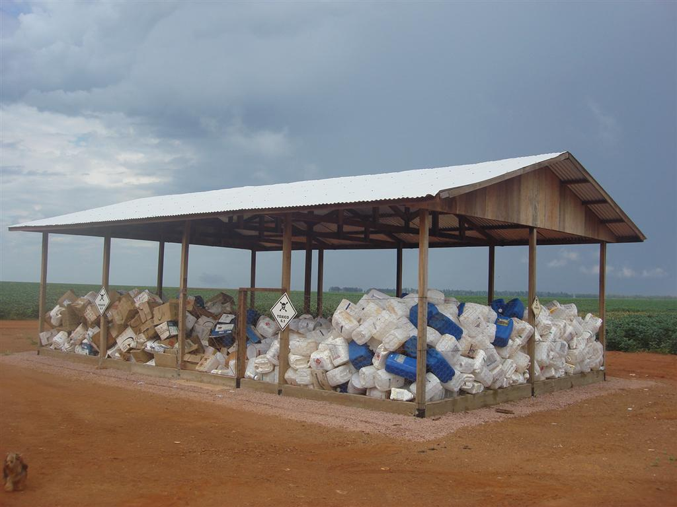
SOJA PLUS FARMS
Empty packagings washed, pierced and placed in a safe location

Slide 36
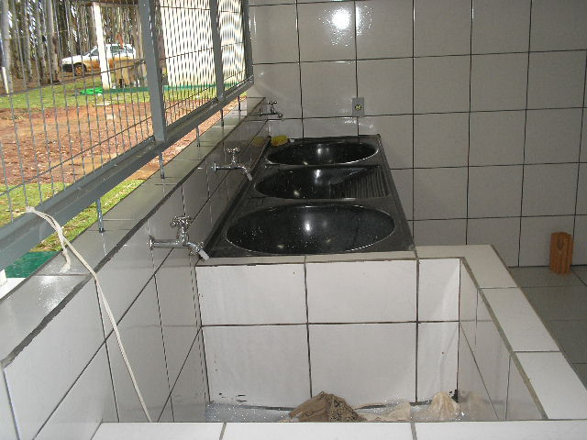
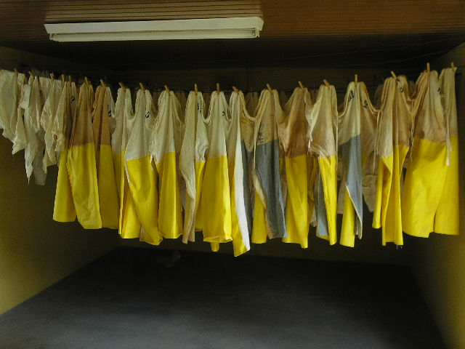
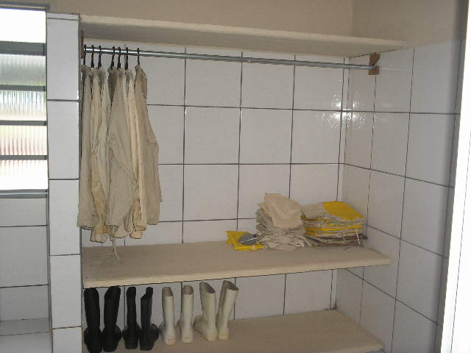
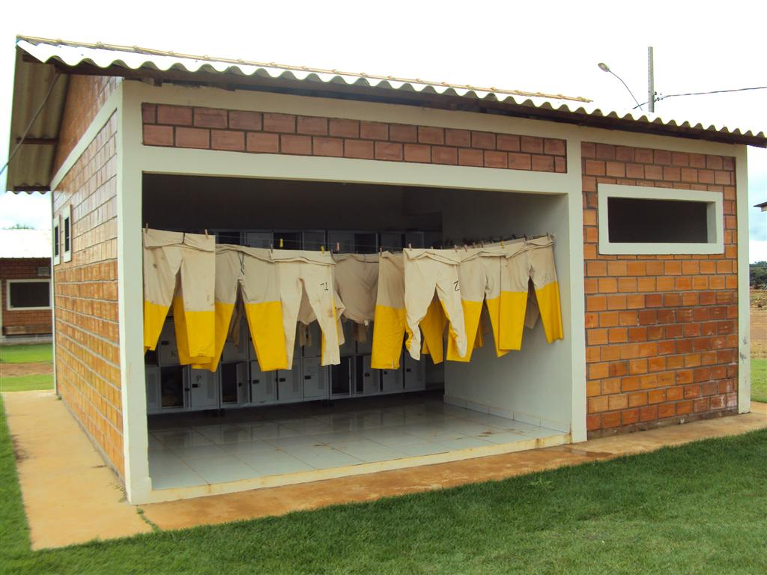
SOJA PLUS FARMS
Protective clothing washed in an appropriate location

Slide 37


COMPLIANCE OF FUEL SUPPLY LOCATIONS
SOJA PLUS FARMS

Slide 38

RURAL ENVIRONMENTAL REGISTRATION
Property Boundaries
Legal Reserve
Area of Permanent Preservation

Slide 39

BOAS PRÁTICAS E NOVO CÓDIGO FLORESTAL

Slide 40


Slide 41


Slide 42


Slide 43


Slide 44


Slide 45


Slide 46


Slide 47


Slide 48




ASSISTÊNCIA TÉCNICA NAS FAZENDAS

Slide 49

Check list com 180 indicadores socioambientais

Slide 50

PRODUTORES PREMIADOS
PREMIAÇÃO DE PRODUTORES DESTAQUES

Slide 51

Números do Soja Plus no Mato Grosso
719 propriedades
1.820.833 hectares
5,46 milhões de ton.

Slide 52


Números do Soja Plus na Bahia
110 propriedades
210.000 hectares
630.000 ton.
95% da soja do Estado da Bahia – 9 municípios - Baianópolis, Barreiras, Côcos, Correntina, Formosa do Rio Preto, Jaborandi, Luís Eduardo Magalhães, Riachão das Neves e São Desidério

Slide 53

Números do Soja Plus no Mato Grosso do Sul
87 propriedades
120.000 hectares
360.000 ton.

Slide 54

Números do Soja Plus Minas Gerais
21 propriedades
15.000 ha
50.000 ton.

Slide 55

Números do Soja Plus Brasil
937 propriedades rurais
2.165.833 ha
6,5 milhões de ton.

Slide 56
PROGRAMAS DE SUSTENTABILIDADE DA ABIOVE
Produção de Soja no Brasil – 96 milhões de toneladas
Moratória da Soja: Desmatamento zero no Bioma Amazônia: 10,8 milhões de toneladas
Programa de Gestão da Propriedade Rural em 4 Estados (MT; MS; MG e BA): 6,5 milhões de toneladas
Total = 17,3 milhões de toneladas – 18% do volume total

Slide 57

Politicas publicas para uma agricultura sustentável

Slide 58

Politicas publicas para uma agricultura sustentável

Slide 59










MUCHAS GRACIAS !!!
www.abiove.com.br
Notes:
11/3/15
59

